Slide 1





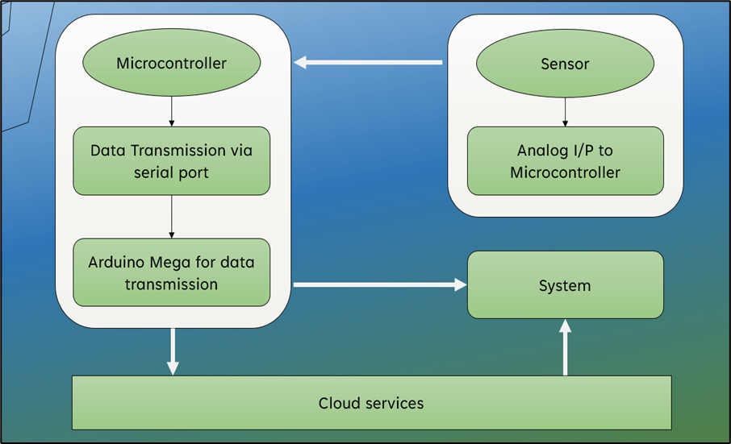
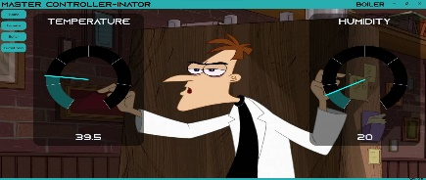
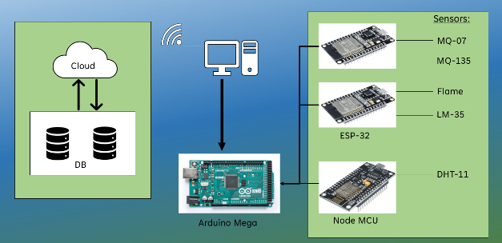
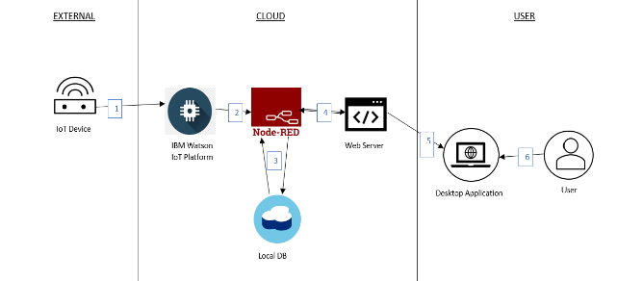
IoT Based Safety Kit For Industrial Workers
Jerrold Gideon S
312319104058
Jerry Britto J
312319104059
ABSTRACT
IoT (Internet of Things) safety kits are designed to provide users with a reliable and easy-to-use solution for monitoring and detecting potential safety hazards in various environments. The human body's exposure to hazardous environments can have a negative impact on our health. These can be avoided by monitoring the industrial areas and alerting the workers when their work environment gets abnormal; this can help the workers take the required measures. A Desktop application can be provided as a dashboard for the administrators to check and monitor with human supervision at anytime when necessary.
INTRODUCTION
MATERIALS AND METHODOLOGY
RESULT
An IoT safety kit might be used to monitor conditions such as temperature, humidity, and air quality in order to ensure the safety and comfort of employees. In a factory setting, for example, the kit might include sensors to detect hazardous gases or chemicals, while in an office. This project is mainly for detecting, monitoring these temperature parameters and displaying it to the industrial workers and providing timely alert to the industrial workers and admins via desktop application.
This Project comprises of an ESP32 board, LM35(Temperature), DHT-11, MQ135, MQ-7, Flame sensor(IR) and Node RED as a cloud platform. First we will make IoT kits for each Industrial room. Each and every device will be connected to the cloud services. We will also have an Arduino Mega to get data from these devices and send them together as one single device. Through this Arduino we can get the data offline. Through the cloud services we can access the data online. We will be having a desktop application which can toggle between online and offline modes. We can access the data via serial port in our application in offline mode. The different modules present are: Temperature sensor module, Humidity sensor module, Air quality sensor module, Carbon Monoxide gas sensor module and IR intensity sensor module.
First methodology is to collect data using Arduino Mega. Second is to upload that data to the IBM Watson cloud. Third is to retrieve that data to local Node-RED server. Finally, display the data in a desktop application (UWP).
As a result of the experiment, a system was developed that could be easily used by construction workers and administrators to check various temperature parameters harmful to the workers. A desktop application to display various information collected via sensors.
CONCLUSION
We hope that our project will be beneficial enough to be implemented in industries across India, saving lives and property from accidents and risks that are often overlooked by industry personnel and users. This would guarantee the safety of all construction employees on the site.
Department of Computer Science and Engineering, St. Joseph’s College of Engineering, OMR, Chennai – 119.
- Mr. S. Vinu M.E, $\overline{Ph.D}$

